Slide 1
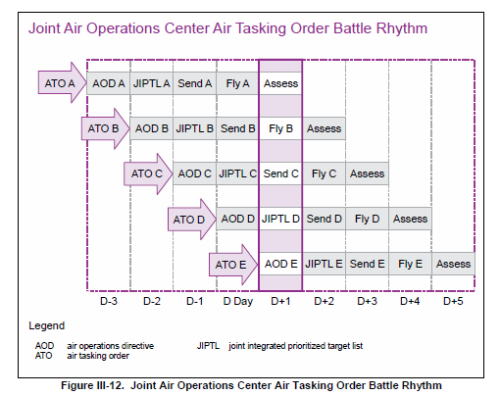
ATO A (D1)
AOD A
JPTL A
ATO A
FLY A
ATO B (D2)
AOD B
JPTL B
ATO B
FLY B
ATO C (D3)
AOD C
JPTL C
ATO C
FLY C
ATO D (D4)
AOD D
JPTL D
ATO D
FLY D
D1
D2
D3
D4

Slide 2
Node: People and things
System
Link: Relationship between nodes
Centre of Gravity

Slide 3
Leadership
Supreme High Command
Army General
Infrastructure
Fielded military forces
Air Force General
Ministry of Defense
Corps
Corps
SAM Regiment
Airfield
Missile factory
FW Air Squadron

Slide 4
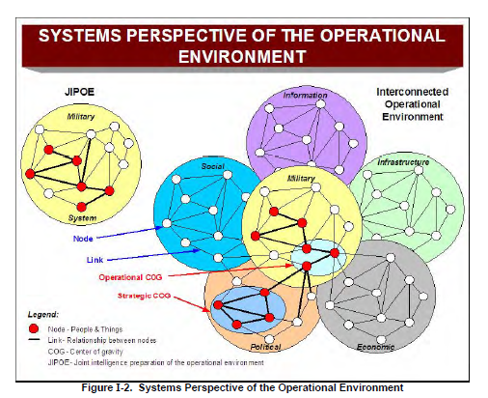
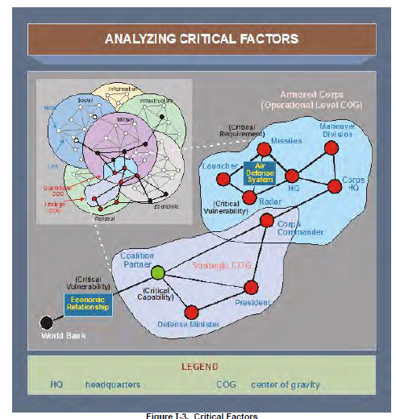
Logistics Regiment
Motorized Division
Critical Capability
Critical Requirement
Armored Division
Missiles
Corps HQ
Air Defense Division
Launcher
HQ
Mechanized Division
Radar
Critical Vulnerability
Rocket artillery Regiment

Slide 5
Centre of Gravity = Integrated Air Defense System (IADS)
Logistics Regiment
Motorized Division
Critical Requirements
Armored Division
Missiles
Air Division
Corps HQ
Launcher
Air Division
HQ
Air Defense Division
Mechanized Division
Force protection
Radar
SA-5 Regiment
Critical Vulnerability
Rocket artillery Regiment

Slide 6
CENTER OF GRAVITY
Critical
Capabilities
Critical
Vulnerabilities
Most effective and efficient points of attack
Critical
Requirements

Slide 7
 | D1 | D2 | D3 | D4 | D5 | D6 | D7 | D8 | D9 | D10
Ground
Air
Navy
WMD
Cyber
Special operations
Resupply
Attack OBJ A
Air superiority ivo OBJ A
Ground attack ivo OBJ A
Alert level 1
Attack Air Defenses ivo OBJ A and B
Recon OBJ A
Recon OBJ B

Slide 8
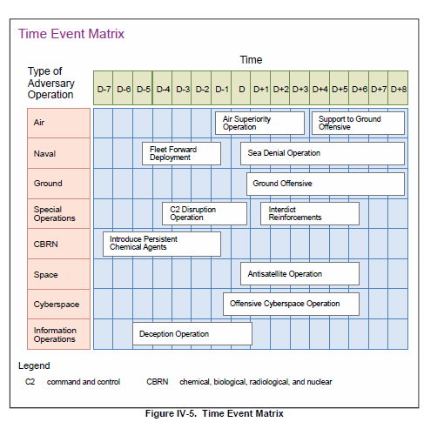
 | D1 | D2 | D3 | D4 | D5 | D6 | D7 | D8 | D9 | D10
Ground
Air
Navy
WMD
Cyber
Special operations
Resupply
Attack OBJ A
Air superiority ivo OBJ A
Ground attack ivo OBJ A
Alert level 1
Attack Air Defenses ivo OBJ A and B
Recon OBJ A
Recon OBJ B

Slide 9
Value | Criticality | Accessibility | Recoverability | Vulnerability | Effect | Recognizability
5 | Loss would contribute to loosing the war | Easily accessible, not in vicinity of security | Extremely difficult to replace, long replacement time | Have the means and expertise to attack | Favorable impact on civilians | Easily recognized
4 | Loss would significantly reduce enemy performance | Easily accessible | Difficult to replace with long down time (months) | Probably have the means and expertise to attack | Favorable impact, no adverse impact on civilians | Easily recognized with training
3 | Loss would reduce enemy performance | Accessible | Can be replaced in relatively short time (weeks) | May have the means and expertise to attack | Favorable impact, some adverse impact on civilians | Recognized with some training/preparation, confusion possible
2 | Loss may reduce enemy performance | Difficult to gain access | Easily replaced in a short time (days) | Little capability to attack | No impact on forces, adverse impact on civilians | Hard to recognize, confusion probable
1 | Loss would not reduce enemy performance | Very difficult to gain access | Easily replaced in a short time (hours) | Very little capability to attack | Unfavorable impact, assured adverse impact on civilians | Extremely difficult to recognize without extensive orientation

Slide 10
Value | Criticality | Accessibility | Recoverability | Vulnerability | Effect | Recognizability
5 | Loss would contribute to loosing the war | Easily accessible, not in vicinity of security | Extremely difficult to replace, long replacement time | Have the means and expertise to attack | Favorable impact on civilians | Easily recognized
4 | Loss would significantly reduce enemy performance | Easily accessible | Difficult to replace with long down time (months) | Probably have the means and expertise to attack | Favorable impact, no adverse impact on civilians | Easily recognized with training
3 | Loss would reduce enemy performance | Accessible | Can be replaced in relatively short time (weeks) | May have the means and expertise to attack | Favorable impact, some adverse impact on civilians | Recognized with some training/preparation, confusion possible
2 | Loss may reduce enemy performance | Difficult to gain access | Easily replaced in a short time (days) | Little capability to attack | No impact on forces, adverse impact on civilians | Hard to recognize, confusion probable
1 | Loss would not reduce enemy performance | Very difficult to gain access | Easily replaced in a short time (hours) | Very little capability to attack | Unfavorable impact, assured adverse impact on civilians | Extremely difficult to recognize without extensive orientation
MLRS from Rocket artillery regiment (Corps resource) likely protected by Corps or Division Air defenses and placed outside artillery range from the FLOT 22

Slide 11
Value | Criticality | Accessibility | Recoverability | Vulnerability | Effect | Recognizability
5 | Loss would contribute to loosing the war | Easily accessible, not in vicinity of security | Extremely difficult to replace, long replacement time | Have the means and expertise to attack | Favorable impact on civilians | Easily recognized
4 | Loss would significantly reduce enemy performance | Easily accessible | Difficult to replace with long down time (months) | Probably have the means and expertise to attack | Favorable impact, no adverse impact on civilians | Easily recognized with training
3 | Loss would reduce enemy performance | Accessible | Can be replaced in relatively short time (weeks) | May have the means and expertise to attack | Favorable impact, some adverse impact on civilians | Recognized with some training/preparation, confusion possible
2 | Loss may reduce enemy performance | Difficult to gain access | Easily replaced in a short time (days) | Little capability to attack | No impact on forces, adverse impact on civilians | Hard to recognize, confusion probable
1 | Loss would not reduce enemy performance | Very difficult to gain access | Easily replaced in a short time (hours) | Very little capability to attack | Unfavorable impact, assured adverse impact on civilians | Extremely difficult to recognize without extensive orientation
Brigade artillery, close to FLOT. Close to a village 18

Slide 12
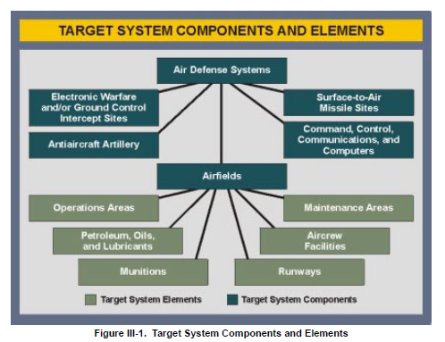
Air Defense Systems
Early Warning Radar Sites
SAM Sites
Antiaircraft Artillery
Airfields
Command, Control, Communications and Computers
Operations Areas
Maintenance Areas
Petroleum, Oils and Lubricants
Aircrew Facilities
Ammunition
Runways
Target System Components
Target System Elements

Slide 13
Air Defense Systems
Early Warning Radar Sites
SAM Sites
Antiaircraft Artillery
Airfields
Command, Control, Communications and Computers
Operations Areas
Maintenance Areas
Petroleum, Oils and Lubricants
Aircrew Facilities
Ammunition
Runways
Target System Components
Target System Elements

Slide 14
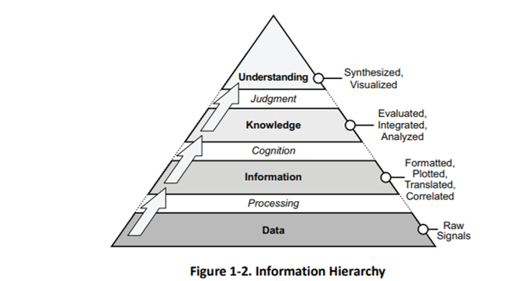
Understanding
Synthesized, Visualized
Judgement
Knowledge
Evaluated, Integrated, Analyzed
Cognition
Information
Formatted, Plotted, Translated, Correlated
Processing
Data
Raw Signals

Slide 15
Understanding
Synthesized, Visualized
Judgement
Knowledge
Evaluated, Integrated, Analyzed
Cognition
Information
Formatted, Plotted, Translated, Correlated
Processing
Data
Raw Signals

